Slide 1
TEEN LURES
High School
Please use your arrow key to progress the presentation

Slide 2
LURES
What is a Lure?
Something that tempts or is used to tempt a person to do something.
In middle school you learned about the following lures:
6th Grade
e-Lure,Cyberbullying
Game Lure
Name Lure
Emergency Lure
7th Grade
Authority
Assistance
Ego/Fame
8th Grade
Affection
Trafficking
Pet

Slide 3
LURES
In 9th grade, we will be talking about the following lures:
Authority
Affection
Trafficking
Notes:
There may be moments in the lesson where you feel you have a connection to what we are discussing, however, we will not be sharing personal stories or things we have heard about during the lesson. If you have a connection or story you would like to share, you can share that in private with your counselor after the lesson is over.”

Slide 4
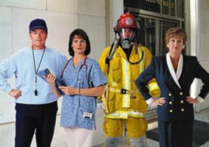
AUTHORITY FIGURES
Who are some authority figures in our lives?
Parents/Grandparents
Other family members
Coaches
Educators/School Staff
Mentors
Doctors
Pastors/Youth Pastors
Law Enforcement
For the most part we are taught to respect and obey authority figures.
Most authority figures are upstanding and law-abiding.
Notes:
Counselor ask students who are some of the authority figures in their lives.

Slide 5
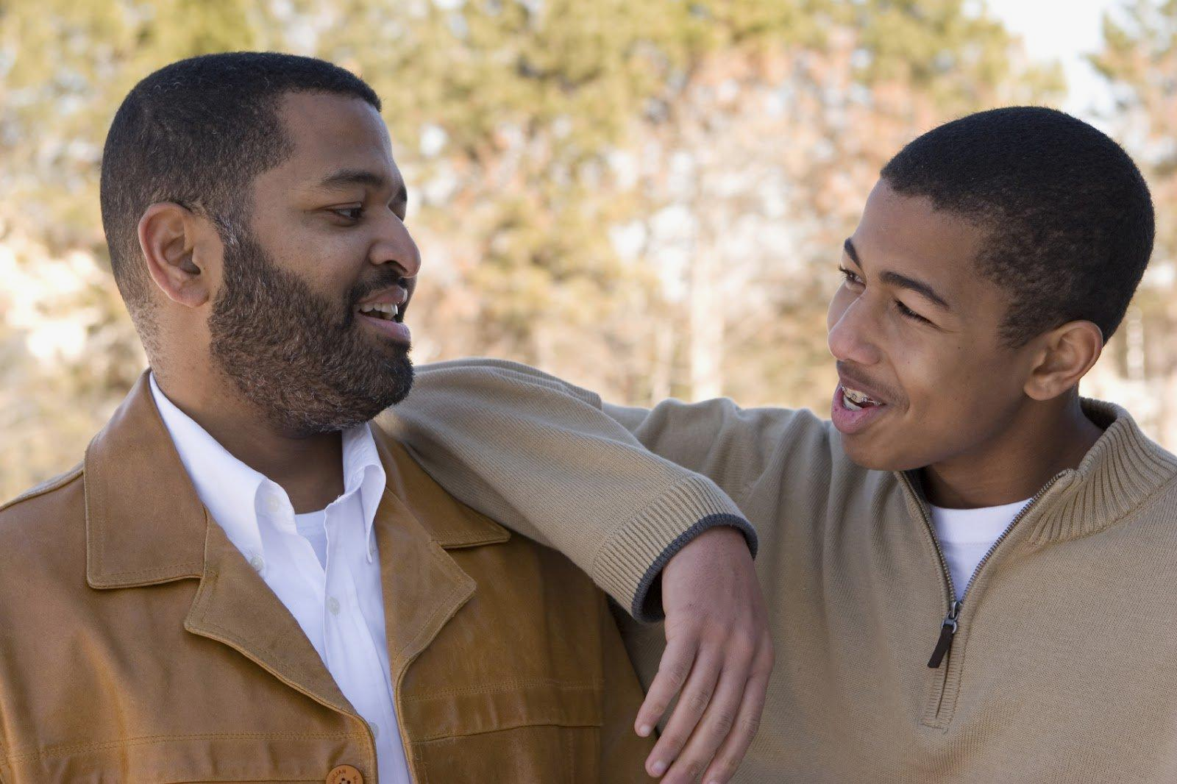
AFFECTION LURE
Some important people in our lives with whom we spend a lot of time with may include: Friends, Parents/Guardians, Teacher, Clergy, Coaches, Relatives, Friends’ Parents/Guardians
Most of the time, when people other than our parents/guardians take an interest in us, it is genuine.
There may be times when we feel no one really understands or cares. Those feelings are perfectly normal, especially for teens.
If teens feel they can’t talk with their parents/guardians, they can talk to a trusted adult.

Slide 6
GROOMING
If someone showered us with attention, gifts and special privileges it may make us like them more and maybe build our trust in them.
These things may make it easier for them to cross the line from appropriate concern and care to inappropriate affection or sexual abuse.
Sex offenders may use flattery to gain a teen’s affection. Flattery is used to groom and lure teens into abuse and exploitation
Other grooming behaviors may include: letting teens swear, play adult video games, vaping, drinking alcohol, or other drugs, and other things parents/guardians don’t usually allow.
If an adult asks you to be secretive about your relationship with them, it is probably an unhealthy or inappropriate relationship.
Notes:
Counselor explains exploitation - Using a minor child for profit, power, status, sexual gratification, or some other purpose

Slide 7
TRAFFICKING LURE
Victims of human trafficking are frequently lured by false promises of a lucrative job, money/fame, stability, education, or a loving relationship.
The International Labor Organization estimates that there are at least 12.3 million adults and children being trafficked throughout the world at any given time.
As estimated 100,000 American citizens are trafficked each year and 18,000-20,000 people from other countries are trafficked into the U.S. every year.
Human trafficking is the second largest crime in the world – right behind drug trafficking.
Human trafficking is a $150 billion industry worldwide, according to the International Labor Organization.
Georgia received 398 calls and 150 reported human trafficking cases since 2017.
-1,118 of the sex trafficking cases in Georgia include minors. Average age of entry for victims is 12-14. (https://law.georgia.gov/key-issues/human-trafficking)
Notes:
Trafficking is not just a problem that people in other states or other areas of the world have to worry about. Trafficking does happen in Georgia, especially in the greater Atlanta area. The average age of

Slide 8
Signs of Teen trafficking
Does your friend have a new older partner who they don’t want you to meet?
Do they have new clothing, cash, or lavish jewelry/accessories?
Makes references to frequent travel to other cities
Have they dropped out of sports, clubs, or activities they used to love?
Do they skip school often? Have their grades dropped?
Have they stopped hanging out or disappeared for periods of time and refuse to tell you where they have been?
Are they constantly on the phone and won’t tell you who they are chatting with?
Do they have injuries, bruises, or new tattoos they won’t discuss?

Slide 9
SUPPORTING A FRIEND WHO IS THINKING ABOUT RUNNING AWAY
The National Runaway Hotline
Call: 1-800-RUNAWAY (1-800-786-2929)
Text: 66008
Georgia Cares
For treatment and care for child victims of sexual exploitation
Call: 1-844-842-3678.

Slide 10
SUPPORT FOR TEENS WHO ARE VICTIMS OF TRAFFICKING
The National Human Trafficking Resource Center
Call: 1-888-373-7888
Text: HELP or INFO to 233733
Available 24 hours a day/7 days a week in over 200 languages.
Remember that if you are not receiving the help you need, keep telling! Seek additional help by telling a counselor or another trusted adult.

